Slide 1

Refactoring HtmSerializer
Khaled Kandil
Erdi Tras
María Sanz Piña
Liam Hosier

Slide 2
HTMSerializer
Introduction
Serialize
Deserialize
Refactoring
UnitTests
Methods

Slide 3
Introduction
What is the HtmSerializer?
Purpose of the Serialization and Deserialization
What is the Unit Tests and Refactoring?
Objective of our task
Notes:
Our project is Refactoring HtmSerializer.
Our project have 4 main step; Let us explain these steps in more detail.
Firstly, What is HTM? What does it do? A Hierarchical Temporal Memory (HTM) serializer is a software component that is designed to convert HTM objects into a serialized format.
HTM is a machine learning algorithm developed by “Numenta” that is based on principles of neuroscience and is designed to recognize patterns in data streams, such as those found in sensor data or natural language.
- We have the important part of our project. The purpose of serialization is to convert an object's state to a format that can be stored or transmitted over a network, and then later restored to its original state using a process called deserialization. Deserialization is opposite of the serialization. Also have some methods to serializing.
- Other important part of our project is Unit Tests and Refactoring. HTM serialization unit tests are an important part of the software development process. Help to ensure that the serializer works correctly and is free of bugs or errors.
Sometimes some unit tests related to our project may give errors when we debug. We are also making some changes in the source code to eliminate these errors.
-Refactoring a Hierarchical Temporal Memory (HTM) serializer would involve making improvements to the design of the serializer without changing its overall purpose. This can be particularly important in the field of machine learning.
- Our task is refactoring the code of the HTMSerializer File with using all Unit Tests (HtmSerializationTests). This means making the code more legible and understandable. In order to do that, we are going to separate the methods that use serialize and deserialize in two classes.

Slide 4
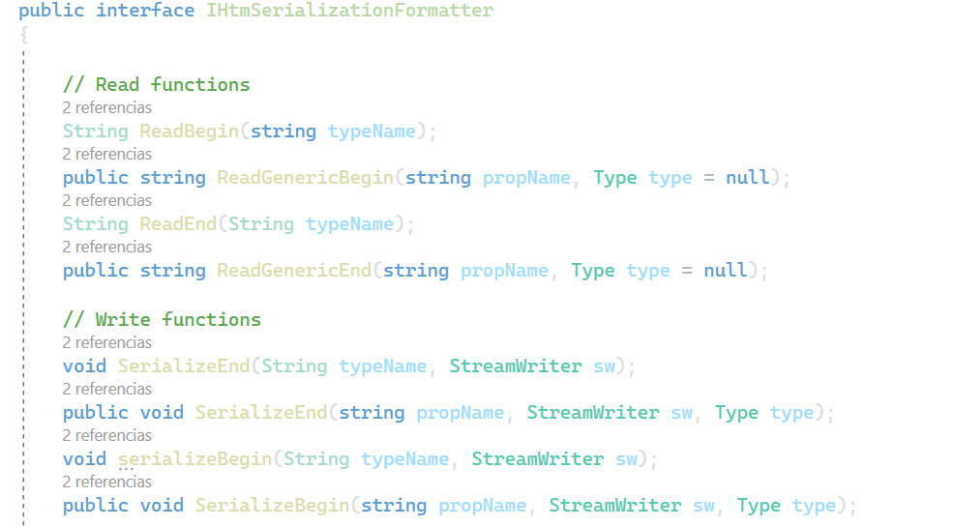
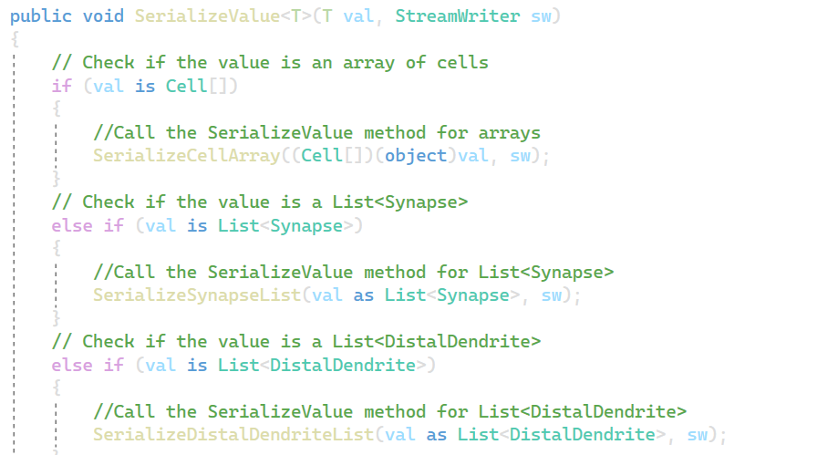
Methods
Notes:
We have lots of metods in our HTMSerialize.cs file but we are going to focus on those that are serilizing. A Serialize method is a method that converts an object to a specific format. In our code, those methods are SerializeBegin, which indicates the start of the serialize object, SerializeEnd, to indicate the end of the serialize object.
And then we have SerializeValue and DeserializeValue. The Serialize methods as we said before, converts an object to a specific format, such as XML. This object can be a simple variable like an int or a double or a list of properties of a Cell like a Synapse or a Dendrite. In the case of the Deserialize methods, it converts the serialized data back into an object or a set of objects.
Also, method overloading happens in our code, which means we have methods with the same name, for example SerializeValue but each of them takes different parameters. Because we had lots of methods called SerializeValue, an implementation we did, was in the example of create one generic SerializeValue regardless of the type of parameter.
Refactoring could be compared to editing a book: the final product of the correction is not a new book, but the same text, but more understandable. Thus, just as in book editing procedures such as rephrasing and sentence restructuring or deletion are used, in code refactoring methods such as encapsulation, reformatting or extraction are applied to optimize the code without changing its content.

Slide 5
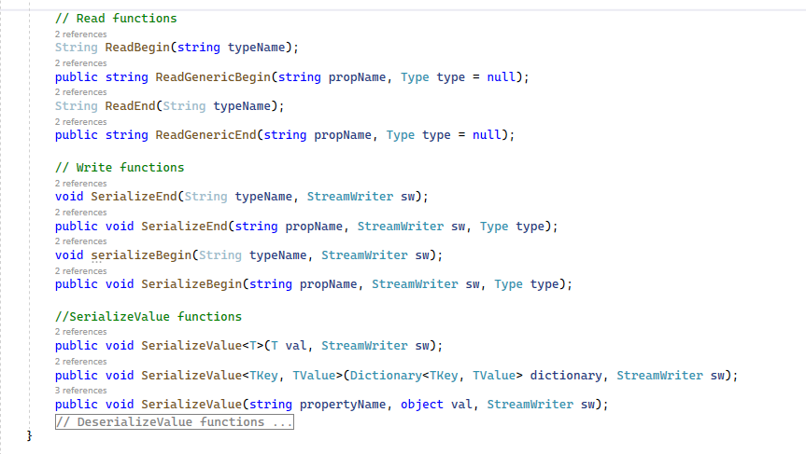
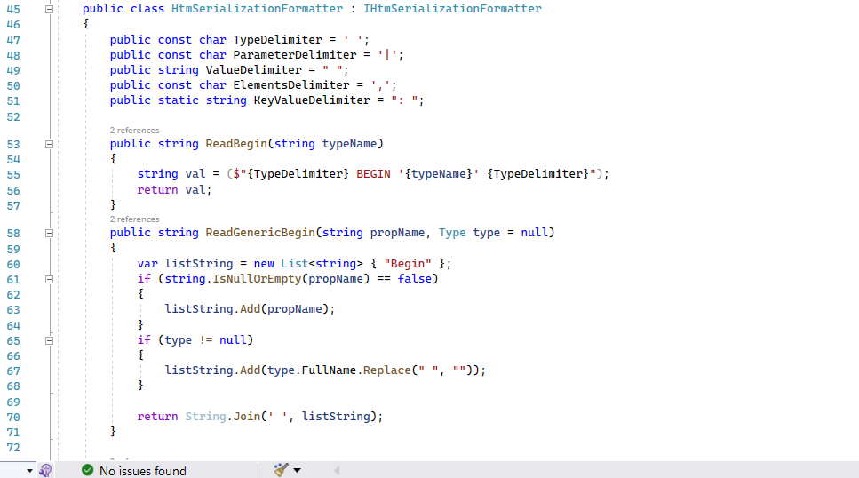
Refactoring & Unit Tests
Refactoring: is the process of improving the structure and design of existing code without changing its external behavior.
Notes:
So, what have we done to achieve this?
In our case what we did was first classify the mehods we have in two: the methods that involve serialization logic code (i.e., method Serialize1()) and the ones that serialization formatting code. The formatting code involves all the methods that use the StreamWriter or Reader. (Some methods have as a parameter the Streamwriter but do not use it inside→ then not includede)
That's what we have done here, we have created an Interface IHtmSerializationFormatter which included all formatting methods using Stream writer or stream read
Improved testability: Static methods can be difficult to test, as they often have hidden dependencies, Removing static methods and replacing them with instance methods can make code easier to test. By removing static methods and using instance methods, you can create more flexible and extensible code.
Now the new HtmSerializer will be instantiated with: var serializer = HtmSerializer(formatter = new HtmDefaultTextFormatter (..))
After finishing the refactoring part we had a lot of errors in the UnitTest, so the last of our task was fixing these UnitTests.
To sum up, we have documented all the methods, explaining how they operate, and their parameters, with expected their output and we have made the code more understandable by doing refractoring

Slide 6
Problems during the Project
Analyzing the code => More than 2000 lines of code
Unit Tests => Unit test error before refactoring
Refactoring => UnitTest, static methods, formatter

